Slide 1
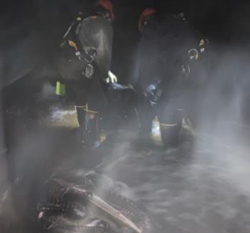
Procedure for fish rescue from turbine dewatering
Bob Cordie
The Dalles Fisheries Section
March 2021

Slide 2
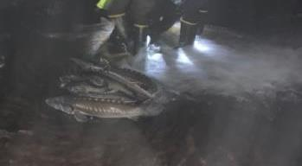
Typical sturgeon size for draft tube

Slide 3
Main unit cross section–35’ depth fish save mode
Notes:
TW right, FB left
Draft tube floor -15’ el
Fish save mode – 20 el, just under hatch door
Tailwater - ~70 el, half way up scroll case

Slide 4
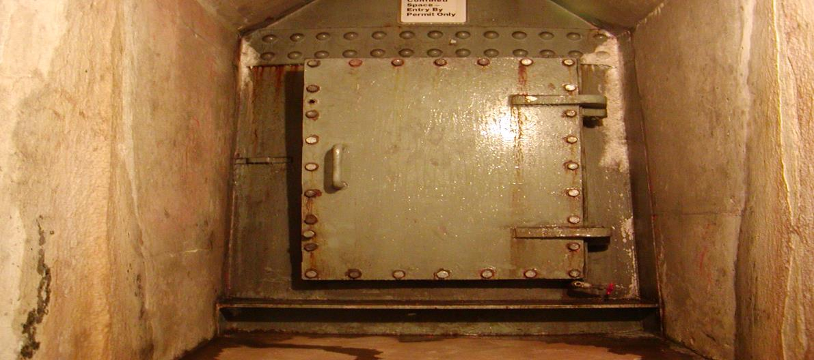
Draft tube hatch
Approx 4’x4’ personnel access and fish egress
Fish are bagged (Salmonids placed in separate bag and removed first if possible), removed by the tugger, and then placed into the fish tank that has been placed in the gallery prior to fishing the unit. Raw water is obtained at the first floor (where?). Should the tank be aerated? Where is the lid? How many fish in tank? The tank is pushed to the nearest shaft, where a rigger secures it for removal to the fourth floor.
Notes:
Small access, hoist arm installed, fish bags used

Slide 5
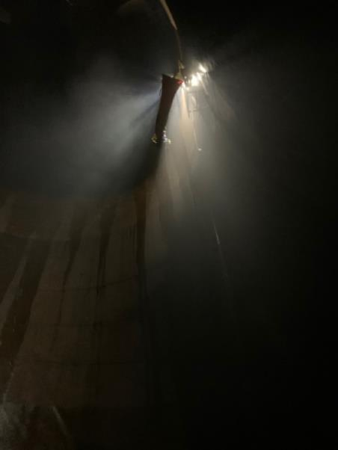
6-7’ sturgeon hoisted by stretcher from draft tube floor
Notes:
Recent sturgeon too large for bags. EMT stretcher tried.

Slide 6
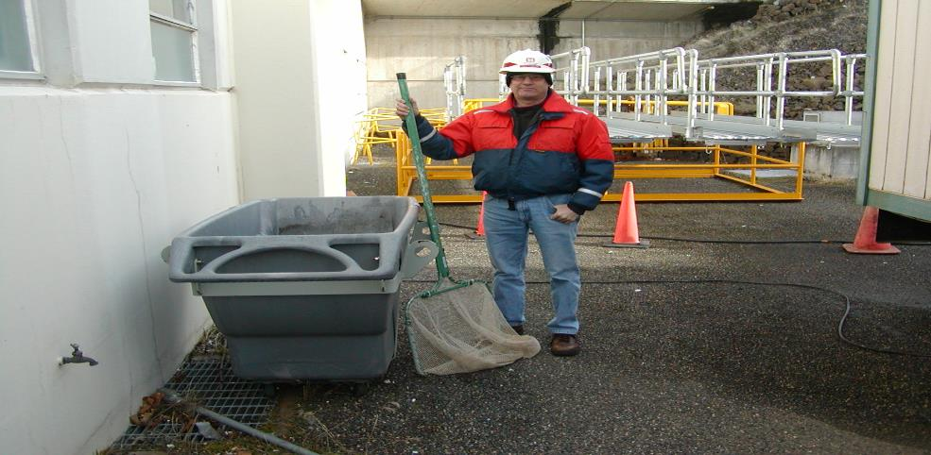
Fish salvage tank
Small enough to fit through gallery hatch. Too small for sturgeon >6’. Too large for draft tube.
Notes:
Tanks used for high sturgeon numbers. Fresh water supply in gallery.

Slide 7
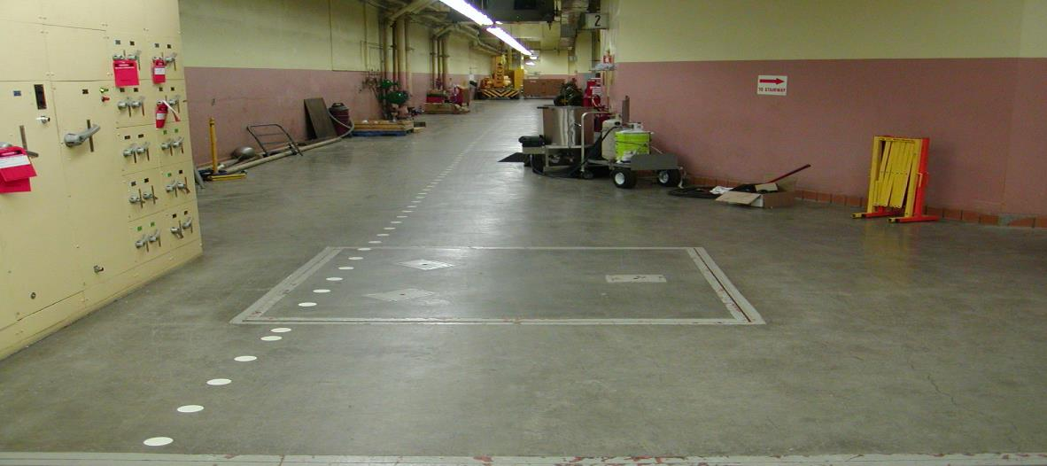
Hatch above draft tube gallery
6’x6’ hatch leading from draft tube gallery.
Notes:
Crane pulls up through hatch

Slide 8
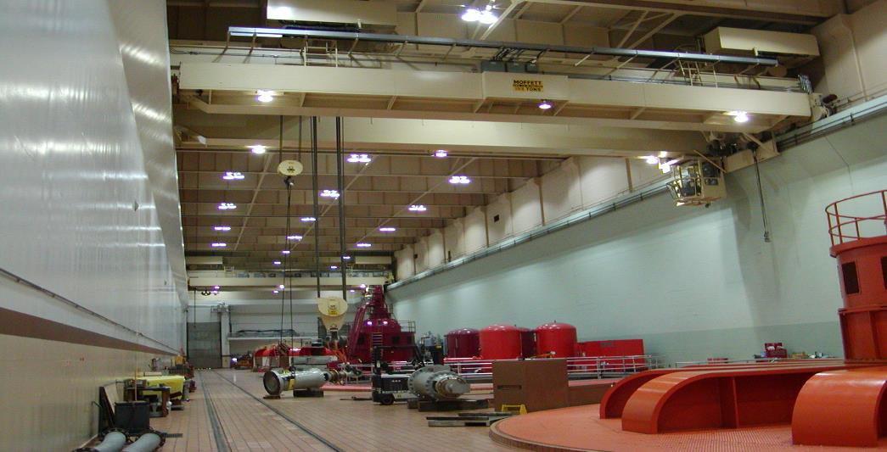
Powerhouse gantry crane
Transports tank to powerhouse door
Notes:
Powerhouse crane

Slide 9
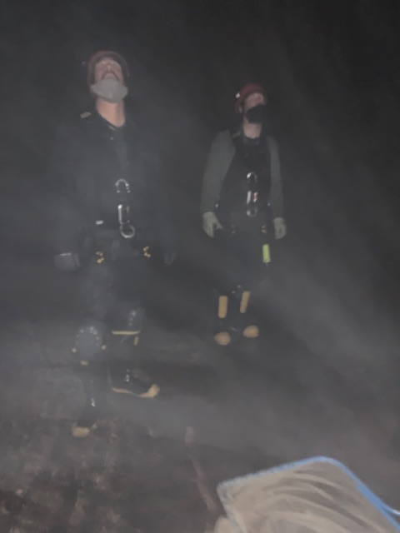
Can I come out now?
Notes:
Personnel in bottom of draft tube after a fish rescue

